Slide 1
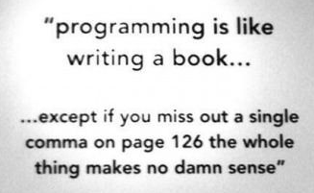
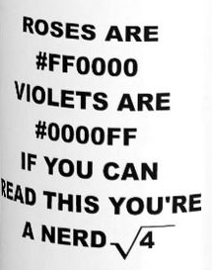
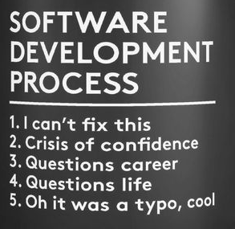
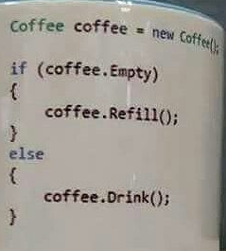
CSC 200 Lecture 6
Digital representation of data
Logical operations

Slide 2
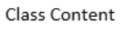
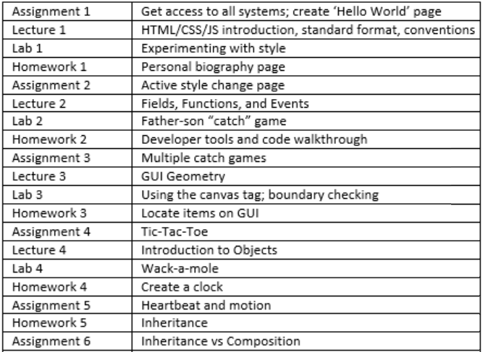
Good News
This first month has covered all the basics of programming.
From here on we aren’t going to cover any new programming concepts.
So what you have now is all the new programming you need to learn for the semester.
You have nine more weeks to get good at it.

Slide 3
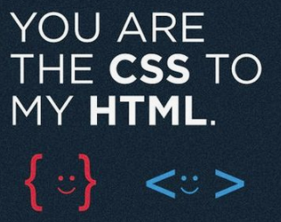
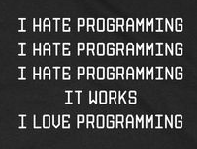
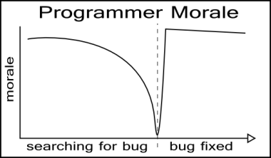
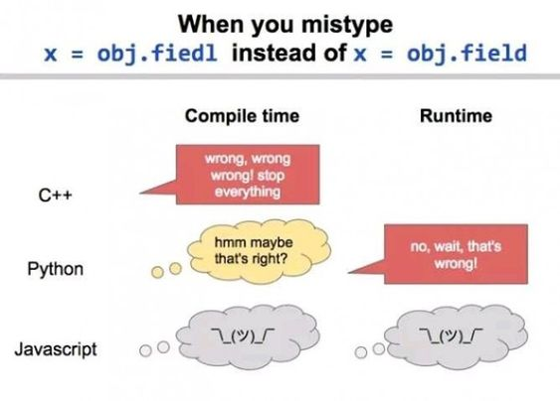
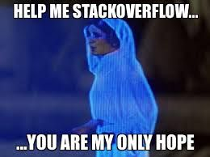
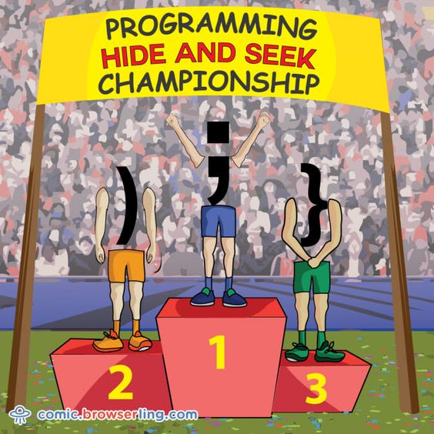
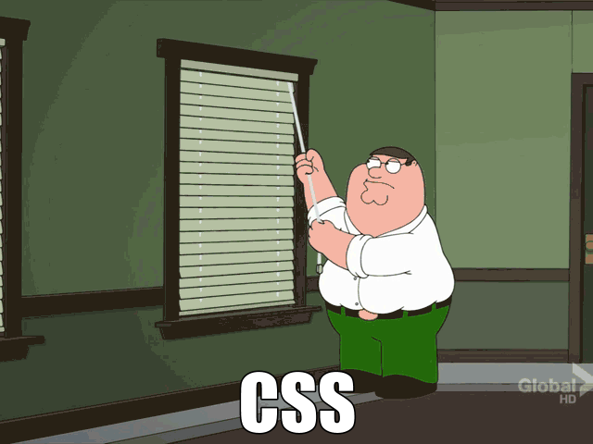
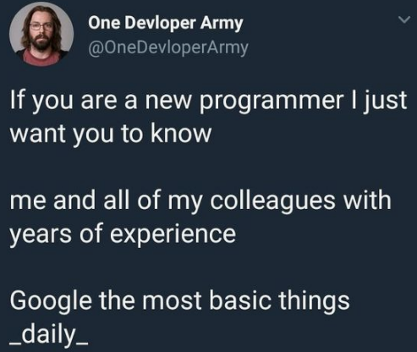
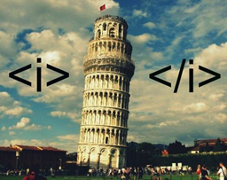
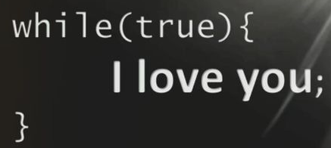

Slide 4
More Good News
The rest of the class will cover academic subjects in lecture.
These are topics that help you understand the computer better.
Understanding the computer better can make you a better programmer.
Like learning about the culture in a foreign language class.
Computer literacy is VITAL to life today.
Digital data representation
Computer Architecture
Computer Stack
Theory of Computing
Computing at Scale
Security
Artificial Intelligence
Software Engineering
Algorithm Efficiency
Programming Languages

Slide 5
Bad News
There are still two more tests @ 20 points each.
Test 2 – March 19
Actually program in class – 2 hours 15 minutes.
Build a function to take two numbers and output the sum to a tag with id “sum”. Create such a tag. Call the function with values 3 and -7. Save this page as Problem 1.
Copy https://bsdillon.github.io/cs200_Spring2020/Test2/Starter3.html. Create the missing functions “IsXWithinBounds” and “IsYWithinBounds” according to the description in the comments. Save this page as Problem 3.
Zip together and submit.
Graded by March 20.
Last day to drop – March 23
65 points out of 110
Better final grade prediction
Test 3 – Final exam April 29-May 1
Any testing center.
Academic subjects only.
Randomly created for you.

Slide 6
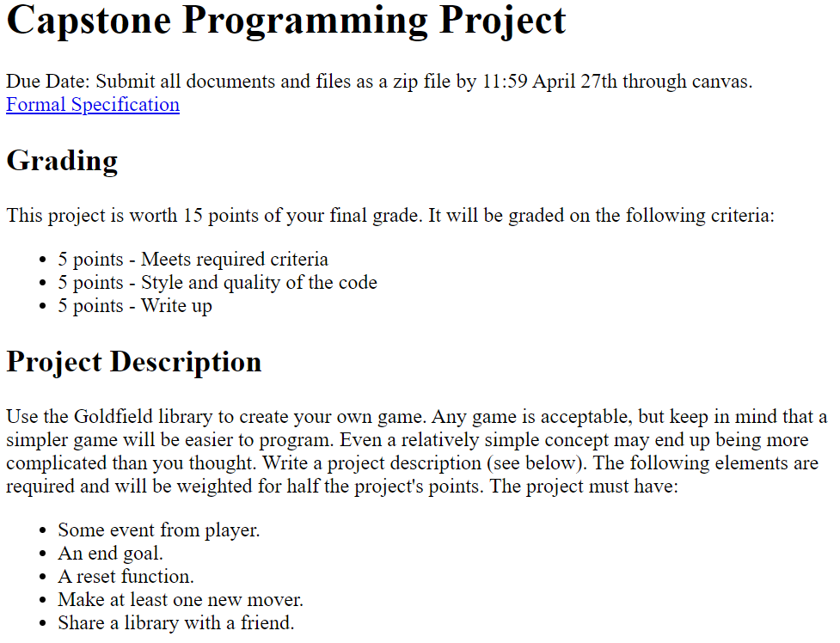
Ugly News
Announcing the capstone project
Almost a test grade @ 15 points.
Due April 27
You have nine more weeks to finish it.
Only 4 more labs – all focusing on using the GoldField API.
Remaining 5 weeks lab time will focus on this project.
https://bsdillon.github.io/cs200_Spring2020/Project/index.html

Slide 7
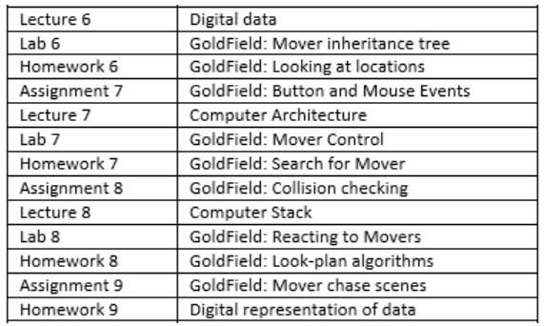
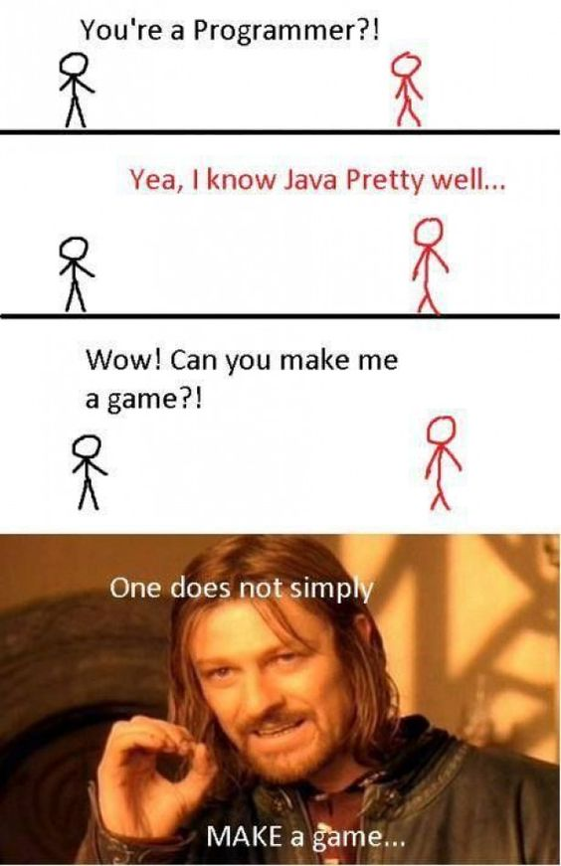
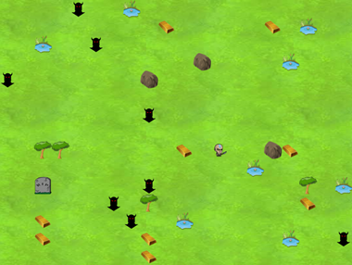
GoldField API
The next four weeks are going to practice everything you already know with GoldField.
This is the API (application programming interface) that you will use for your final project game.
https://bsdillon.github.io/cs200_Spring2020/GoldField/index.html
https://bsdillon.github.io/cs200_Spring2020/GoldField/goldfield.js

Slide 8
Lecture Time!

Slide 9

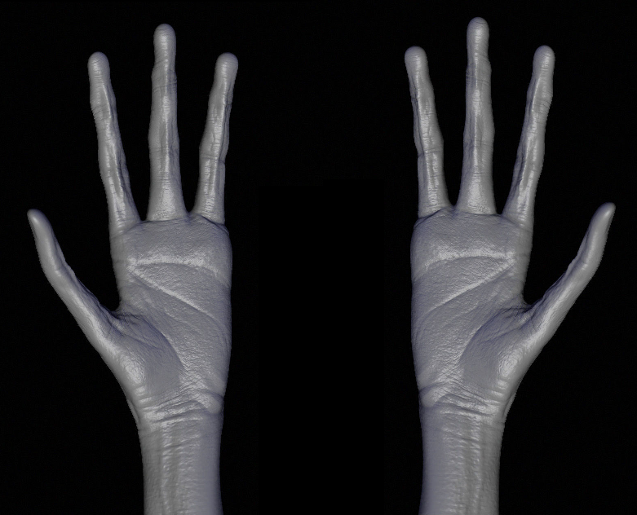
Digital Representation of Data
Our number system is called Decimal.
It is based on the number 10.
This is largely because we have ten fingers.
If we had different hands, we would have a different system.
There is nothing inherently special about the number 10.

Slide 10
Radix 10 Math
From grade school you have learned to read our numbers
Radix 10
Base 10
Place values
Note that places are powers of 10.
10⁶
10⁵
10⁴
10³
10²
10¹
10⁰
1 0 2 8 7 4 3
Millions
Hundred Thousands
Ten Thousands
Thousands
Hundreds
Tens
Ones

Slide 11
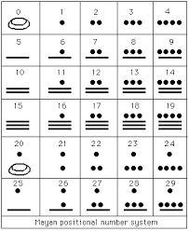
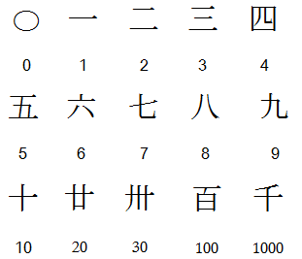
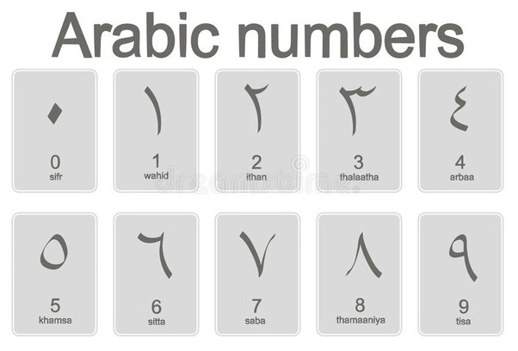
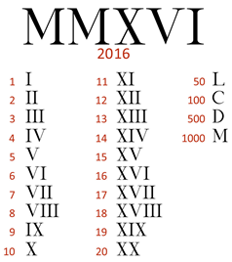
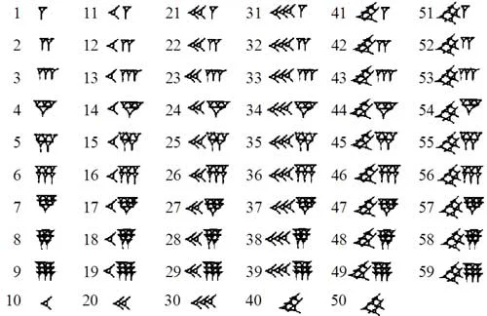
Other Number Systems
Base 10 is not the only system we have ever had.
Many other number systems have been used. Mostly based on:
How many numbers a person really needed.
How accurate you need to be.
Current number system is Arabian.
Arabic – Base 10
(but backwards)
Chinese – Base 10?
(but vertical)
Mayan –Base 20
Roman – WTF?!
Babylonian –Base 60

Slide 12
Modulo Operator
In number systems we talk about the modulus of the number system.
Modulo is the remainder of division. It turns out to be extremely helpful.
Every 10 times if(time%10==0)
Is it even if(num%2==0)
In decimal our modulus is 10.
Dividend
Quotient
17 / 3 = 5 r 2
Divisor
Remainder
Modulo operator
17 % 3 = 2
Modulo

Slide 13
Conversions for Computers
Programmers have to be reasonably comfortable moving between four number systems.
Decimal – Base 10 like you learned in grade school.
Binary – Base 2 is what computers understand and ultimately ALL data is binary.
Octal – Base 8 is hardly ever used except in security and flight transponders.
Hexadecimal – Base 16 is a compressed way of showing binary or decimal.
Base 10
Base 2
Base 8
Base 16

Slide 14
Radix 2 Math
A “binary digit”
or “Bit”
Computers can’t understand our math.
They really only understand electricity On/Off.
Only two numbers 1/0
In spite of the obvious differences, our number system is not that different from binary.
2⁷
2⁶
2⁵
2⁴
2³
2²
2¹
2⁰
One twenty eights
Sixty Fours
Thirty Twos
Sixteens
Eights
Fours
Twos
Ones
0 1 0 1 1 1 0 1
An 8-bit “byte”

Slide 15
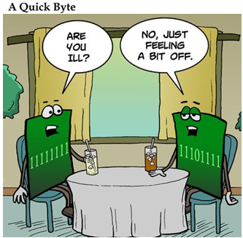
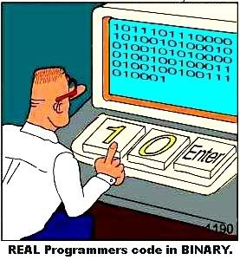
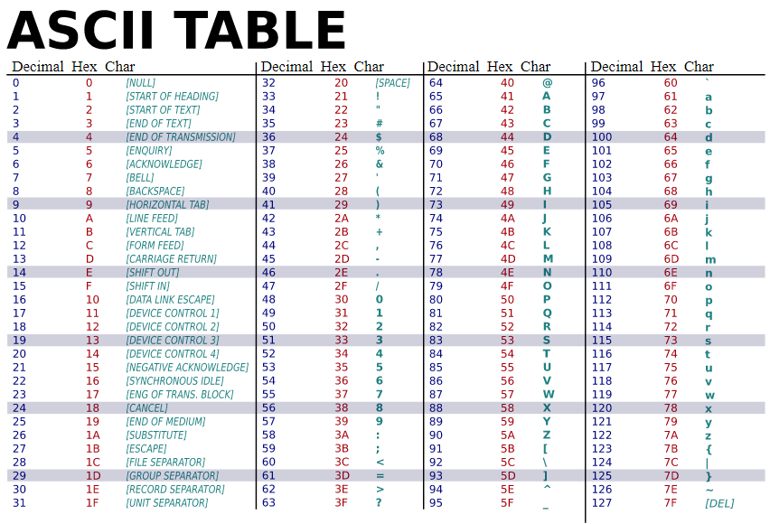
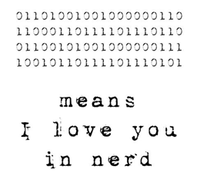

Slide 16
Binary Math
1 1 1 1 1 1
Arithmetic in binary works the same way that it does in base-10.
Carry a two
Borrow a two
Long division and multiplication work the same way.
0 1 0 1 1 1 0 1
+ 0 1 0 0 1 0 1 1
1 0 1 0 1 0 0 0
1
93
+ 75
168

Slide 17
Binary Math (2)
You will not need to do this math yourself, but it is important that you understand that the computer is doing math this way.
Key points
Binary math is similar to decimal math
No one wants to do binary math regularly. ☺
1 11111
10101000
-01001011
01011101
1010
x 1001
1010
0
00
1010000
1011010
1001 __
1010)1011010
-1010
1010
-1010
0

Slide 18
Radix 8 and 16
There are two other number systems that are popular with computers.
Octal (base 8)
Hexadecimal (base 16)
Octal used to be much more useful, but it is still found in some places.
Hex is still used broadly because it abbreviates the numerical notation and perfectly matches a byte.
5
D
0 0 1 0 1 1 1 0 1
1
3
5

Slide 19
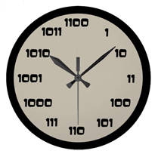

Conversion and Reading
There are two methods to convert decimal to binary.
Pick either, but master one!
Also, you should learn to read hexadecimal numbers. They will show up in our code.
36 = Thir-ty Six
F6 = Eff-ty Six
AB = Ay-ty Bee
Mod & Divide
Subtract & Check
3 / 2 =
6 / 2 =
13 / 2 =
26 / 2 =
53 / 2 =
106 / 2 =
213 / 2 =
1 % 2 = 1
3 % 2 = 1
6 % 2 = 0
13 % 2 = 1
26 % 2 = 0
53 % 2 = 1
106 % 2 = 0
213 % 2 = 1
213 – 128
85 – 64
21<32
21 – 16
5<8
5 – 4
1<2
1 – 1
1
1
0
1
0
1
0
1

Slide 20
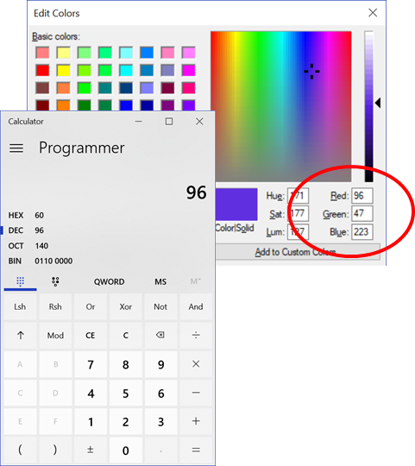
Practice Example
Colors are typically described in 24 bits, three 8 bit numbers (from 0 to 255) for red, green, and blue.
These are often represented as Hex.
You can use any programming calculator to do the conversion.
Let’s practice anyway.

Slide 21
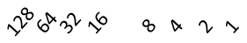
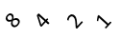
Practice Example (2)
Subtract & Check
96
-64
32
-32
0
47
-32
15
- 8
7
- 4
3
- 2
1
- 1
0
223
-128
95
- 64
31
- 16
15
- 8
7
- 4
3
- 2
1
- 1
0
0 1 1 0 0 0 0 0
0 0 1 0 1 1 1 1
1 1 0 1 1 1 1 1
6
0
2
15
13
15
60
2F
DF

Slide 22
Practice Example (3)
Mod & Divide
96 % 2 = 0
96/2=48 % 2 = 0
48/2=24 % 2 = 0
24/2=12 % 2 = 0
12/2=6 % 2 = 0
6/2=3 % 2 = 1
3/2=1 % 2 = 1
1/2=0 _
47 % 2 = 1
47/2=23 % 2 = 1
23/2=11 % 2 = 1
11/2=5 % 2 = 1
5/2=2 % 2 = 0
2/2=1 % 2 = 1
1/2=0 _
223 % 2 = 1
223/2=111 % 2 = 1
111/2=55 % 2 = 1
55/2=27 % 2 = 1
27/2=13 % 2 = 1
13/2=6 % 2 = 0
6/2=3 % 2 = 1
3/2=1 % 2 = 1
1/2=0 _
1 1 0 0 0 0 0
1 0 1 1 1 1
1 1 0 1 1 1 1 1
6
0
2
15
13
15
60
2F
DF

Slide 23
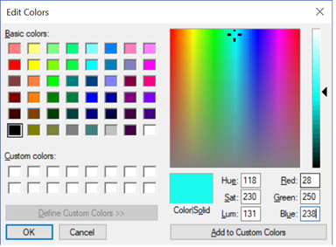
Practice Example (4)
Let’s go the other way!
p {color:#1CFAEE}
1C
FA
EE
0 0 0 1 1 1 0 0
1 1 1 1 1 0 1 0
1 1 1 0 1 1 1 0
1_
16
8
+ 4
28
13_
128
64
32
16
8
+ 2
250
12_
128
64
32
8
4
+ 2
238

Slide 24
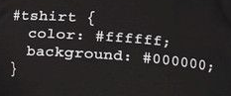
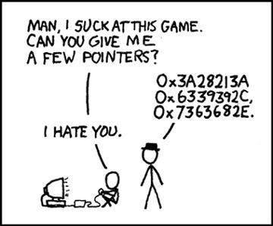
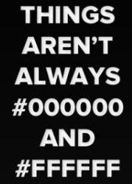

Slide 25
Conversions for Computers
Going back to the conversion map:
Binary is in the middle of everything.
Get good converting to/from binary.
Everything else will be easy.
Ex. Decimal to Hex
Decimal -> Binary -> Hexadecimal
Base 10
Base 2
Base 8
Base 16

Slide 26
Logic and Truth Tables
A | B | A∧B
0 | 0 | 0 _
0 | 1 | 0 _
1 | 0 | 0 _
1 | 1 | 1 _
A | B | A∨B
0 | 0 | 0 _
0 | 1 | 1 _
1 | 0 | 1 _
1 | 1 | 1 _
Logical expressions are the other side of computer math.
AND – Both conditions are true
OR – Either condition is true
NOT – The opposite of the condition.
A | ¬A
0 | 1_
1 | 0_

Slide 27
Boolean Expressions
Code depends on logical statements where decisions are made.
These statements are evaluated as either true or false.
These conditions can be combined in more complicated statements.
The rules can be complicated, leading to hidden bugs.
size < 10
age > 21
x == y
x != y
String equality
state === “normal”
name !== “Dillon”
One of Javascript’s known flaws is the poorly defined equality operator ==
https://eqeq.js.org/
https://dorey.github.io/JavaScript-Equality-Table/

Slide 28
Complex Boolean Expressions
A Boolean expression can be made from smaller Boolean expressions.
Use parenthesis liberally to make it clear what is being tested together.
Complicated = BAD
Complicated still happens
AND &&
OR ||
NOT !
size < 10 && size > 5
age > 21 && buyingBeer
x == y && x == z
x != y || y != z
( name === “Dillon” && age< 21 ) || buyingBeer
age < 21 && hungry && !broke && age > 21

Slide 29
Predicate Logic
A && (B || !C)
This kind of math is called predicate logic.
Truth tables can be used to understand the predicate logic.
This is worth doing when the logic is unclear.
This is not a requirement to program, but it is a useful tool to have in your toolbox.
①
②
A | B | C | ¬C | B ∨ ① | A∧②
0
0
0
0
1
1
1
1
0
0
1
1
0
0
1
1
0
1
0
1
0
1
0
1
1
0
1
0
1
0
1
0
1
0
1
1
1
0
1
1
0
0
0
0
1
0
1
1

Slide 30
For the Exam
You need to be able to:
Convert numbers from one base to another
Create a truth table from a Boolean expression.
Explain when/where/why each bases is used.
Decimal – humans can easily handle this math on their hands.
Binary – computers can easily handle this math on their chips.
Hexadecimal – compressed representation of binary
Octal –rarely used anymore e.g. security and air transponders

